Slide 1
Final Project
Brandon Wisniewski

Slide 2
The point
Build a pokemon based world as an expansion of the pokemon project
Select pokemon, walk around battle trainers
TRY to Implement a framework that properly implements OOP concepts

Slide 3
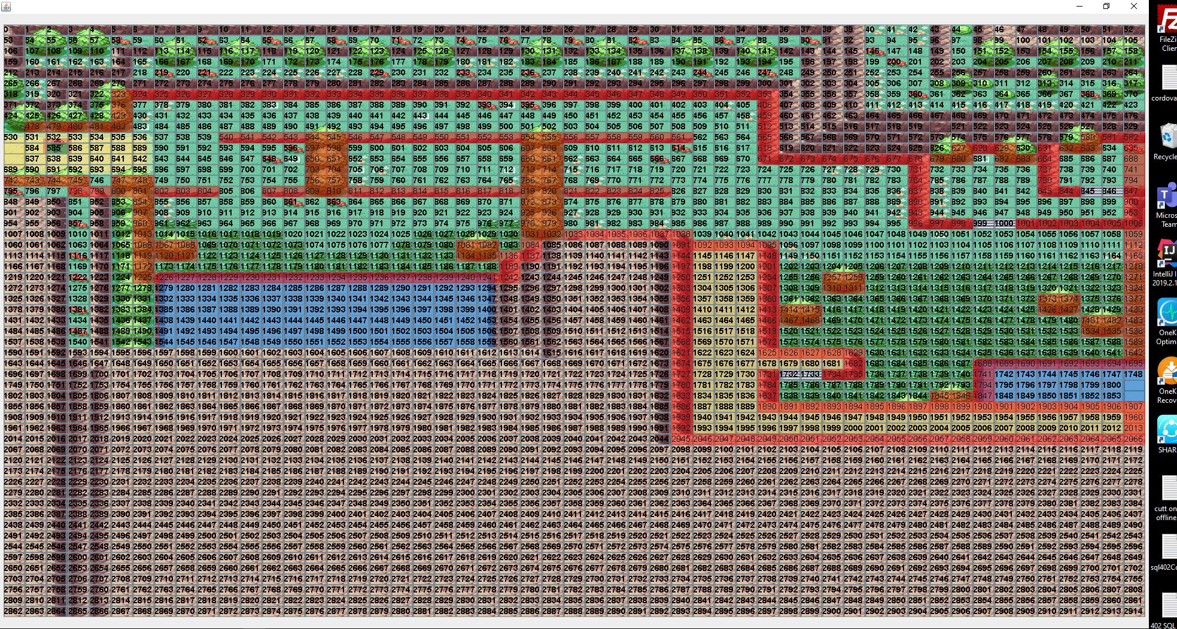
Collision Boxes

Slide 4
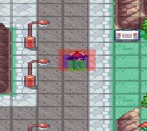
The User

